Slide 1





ARENA
01
Presented by
Ettisaf Rup,
Software Lead, XtendArena
xtendarena@2026 | All Rights Reserved

Slide 2




02
WHAT IS CLEANWRAP?
CleanWrap is a fast, lightweight, and modular Windows desktop file organizer written in Modern C++20. It automatically scans messy folders and sorts every file into clean, well-structured categories — all in a matter of seconds.
Designed to be a true native Windows utility, CleanWrap has zero runtime dependencies and leaves no background processes running.
It simply runs, organizes, and exits cleanly.
Lightweight
Minimal & Fast
Open Source & Modular Design

Slide 3

03
BRANDING &
VISUAL IDENTITY
CleanWrap's visual identity is built on a modern, tech-focused aesthetic with a deep navy to purple gradient palette, clean typography, and a distinctive ribbon bow logo mark.
CleanWrap Logo
Color Palette
CleanWrap
Publish Inc. XtendArena
A sleek ribbon bow icon paired with bold modern typography. Represents clean, organized, and efficient file management at a glance.
Primary: Blue (#4A90E2),
Purple gradient, Dark navy backgrounds. Conveys speed, trust, and modern Windows-native software design.
XtendArena's logo anchors CleanWrap's identity as part of a professional software ecosystem, ensuring brand consistency across products.

Slide 4


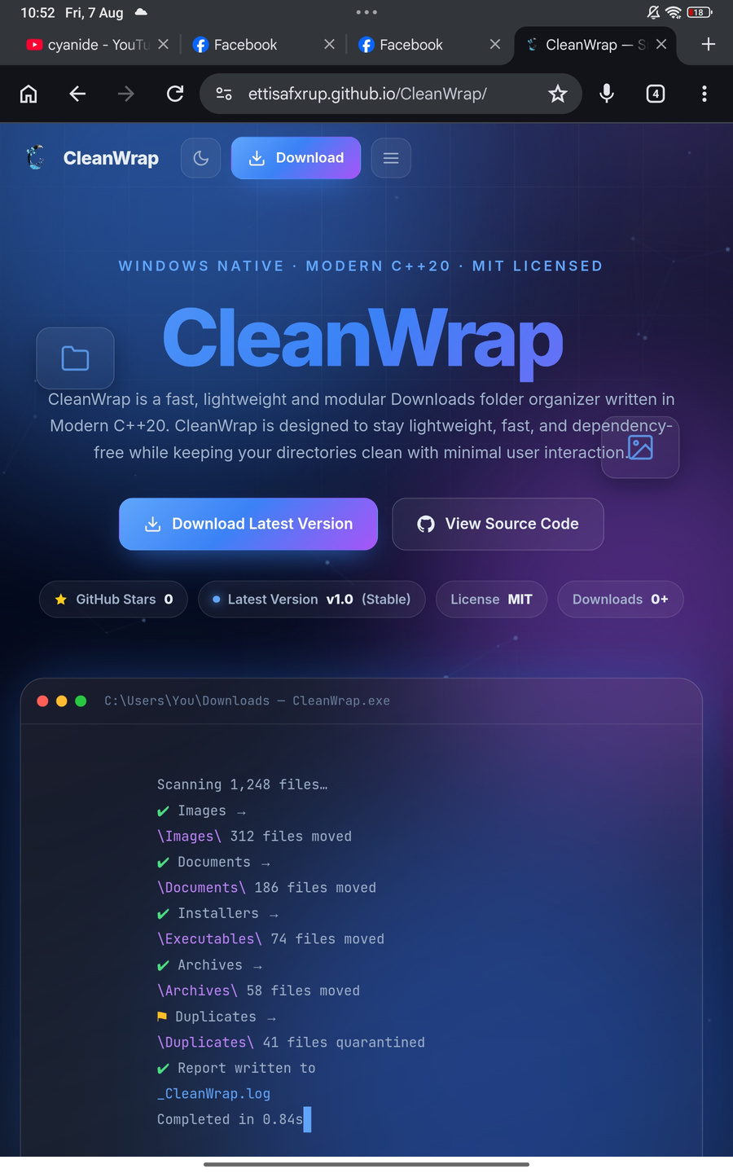
ARENA
04
CORE INFORMATION AT A GLANCE
Version 1.0 stable — released August 2026
8 MB install size — 1,500 files per second
9+ categories — hundreds of extensions supported
CleanWrap Version 1.0 launched August 2026, delivering blazing-fast performance with zero runtime dependencies and a minimal footprint.
100% free & open source — MIT Licensed

Slide 5

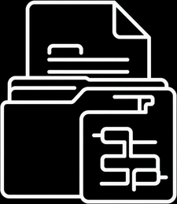

ARENA
05
SUPPORTED
Media Files
FILE TYPES
It Supports Almost Anything we use
in our Daily Life!
Documents & Data
CleanWrap recognizes hundreds of file extensions across 9 smart categories — all sorted automatically in under a second.
System & Code Files

Slide 6
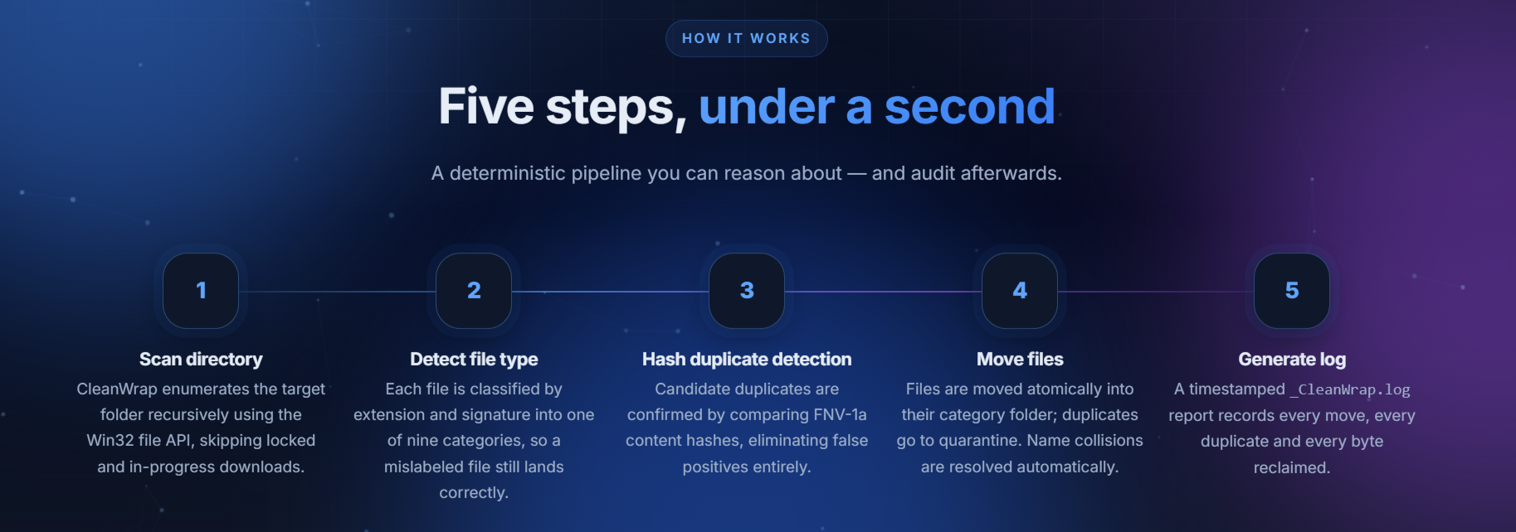
06
HOW CLEANWRAP WORKS
CleanWrap runs a deterministic five-step pipeline — scan, detect, hash, move, and log — completing the entire process in under a second. No configuration needed, no files deleted, and no data lost.
5
JUST STEPS,
AND THOUSANDS OF MESSEDUP FOLDERS ORGANIZED WITHIN A SECOND

Slide 7
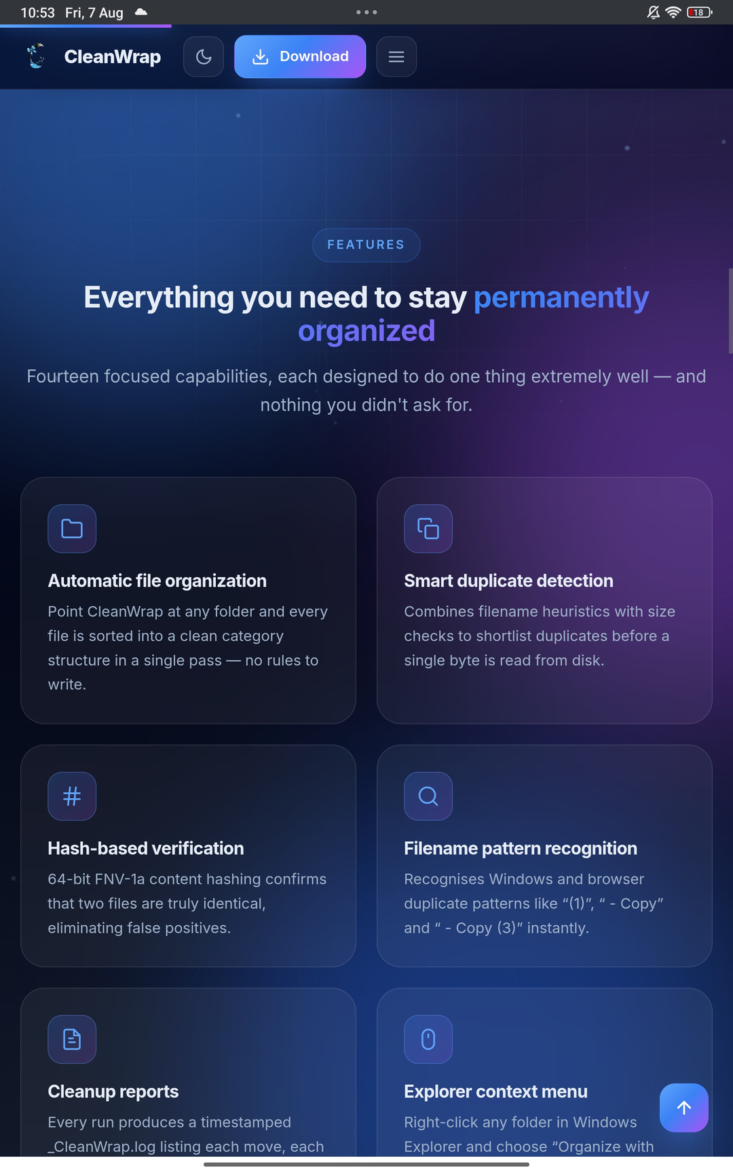
ARENA
07
Hash-based verification — 64-bit FNV-1a content hashing
Automatic file organization — no rules needed
Filename pattern recognition — Windows/browser duplicates
Smart duplicate detection — heuristics + size checks
Key Features - CleanWrap
Lightweight — no background service, no RAM bloat
Smart folder creation — only when needed
Windows native — pure Win32 & Shell API, no Electron
Safe file moving — atomic renaming, zero deletions

Slide 8
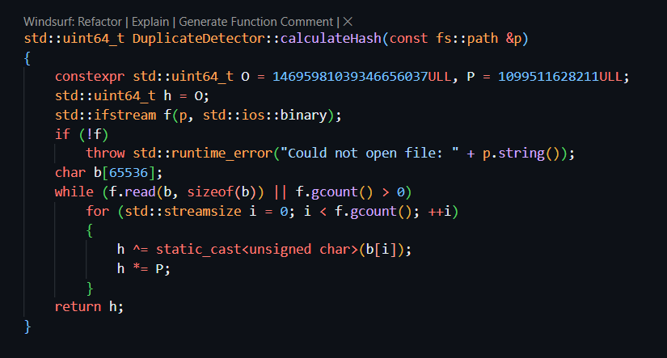
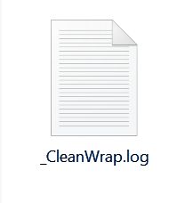
09
Heuristics + Hash Verification
CleanWrap first shortlists duplicate candidates using filename heuristics and file size matching — a fast, low-cost pre-screen. Confirmed matches are then verified using 64-bit FNV-1a content hashing, eliminating all false positives before any file is moved.
Recognizes common Windows duplicate patterns such as "(1)", "- Copy", and "- Copy (3)". All confirmed duplicates are safely relocated to a quarantine subfolder for easy review — no files are ever permanently deleted.
DUPLICATES
HANDLING
EXPLAINED
Quarantine & Pattern Recognition
Every duplicate move is recorded in the timestamped _CleanWrap.log file, giving users a full audit trail of what was detected, why it was flagged, and exactly where it was moved. Rollback is straightforward using the log as a reference guide.
FNV-1A

Slide 9
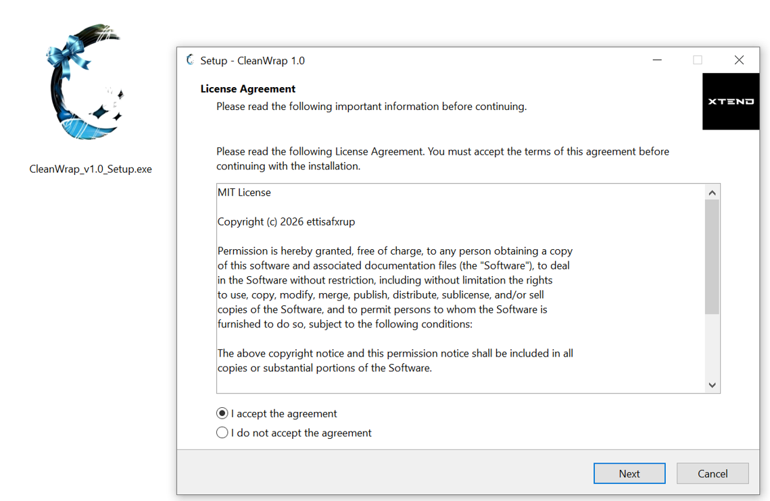
INSTALLATION PROCESS
10
01
Download the Installer
Visit GitHub Releases or the official website and download CleanWrap-Setup-1.0.0.exe. The installer is only ~8 MB with zero runtime dependencies required.

Slide 10
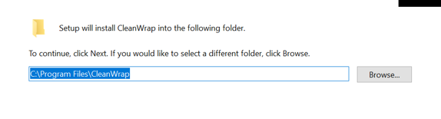
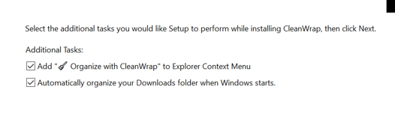
INSTALLATION PROCESS
10
02
Run & Configure
Run the installer and accept the prompts. Choose the startup option to auto-organize your Downloads folder on Windows startup and enable Explorer context menu integration.

Slide 11
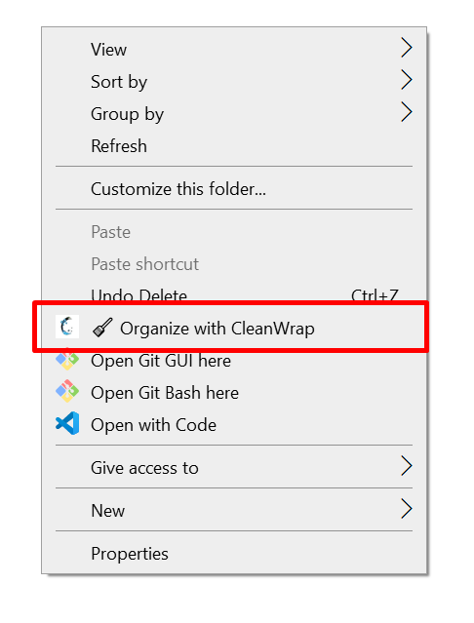
INSTALLATION PROCESS
10
03
Launch & Organize
Finish setup and launch CleanWrap. Your first cleanup report appears within seconds — folders are sorted, duplicates quarantined, and a timestamped log is generated.

Slide 12


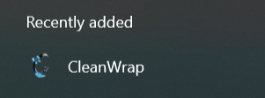
11
Launch & Organize
Right-Click Any Folder
Open CleanWrap to instantly organize your Downloads folder. Sorting completes in seconds with a full cleanup report generated automatically.
Right-click any folder in Windows Explorer and select "Organize with CleanWrap" to sort it instantly via the context menu integration.

Slide 13



13
A MESS FROM ANOTHER MESS!
CleanWrap started as a weekend script to solve Ettisaf's own cluttered Downloads folder. It evolved into a full-featured, open source Windows utility. Later on, popped up as a idea saying, “why not?”
Ettisaf Rup is a regular computer guy with a BSc. in Computer Science & Engineering from KUET. He serves as Software Lead at XtendArena, where he focuses on building fast, native software and systems programming.
Education & Role
Creator of CleanWrap
BSc. CSE, KUET. Software Lead at XtendArena. Passionate about native desktop software and systems programming.
Started as a weekend script. Evolved into a full app. GitHub, LinkedIn, Facebook, Instagram — @ettisafrup

Slide 14



ARENA
14
Star us on GitHub
SUPPORT
Give CleanWrap a ⭐ on GitHub to help with visibility and motivate continued development. Open source contributions, bug reports, and pull requests are always welcome.
& COMMUNITY
Donate & Support
Give a star on GitHub to boost visibility. Contribute code, report bugs, or share CleanWrap with others.
Source code and user manual are freely available on GitHub under the MIT License.
Support CleanWrap via Bank transfer or bKash mobile payment. Every contribution helps fund new features and keeps the project alive and growing.
Join the Community
Follow and connect on GitHub, LinkedIn, Facebook, and Instagram. Source code and full user manual are freely available. Join the community and help shape CleanWrap's future.

Slide 15
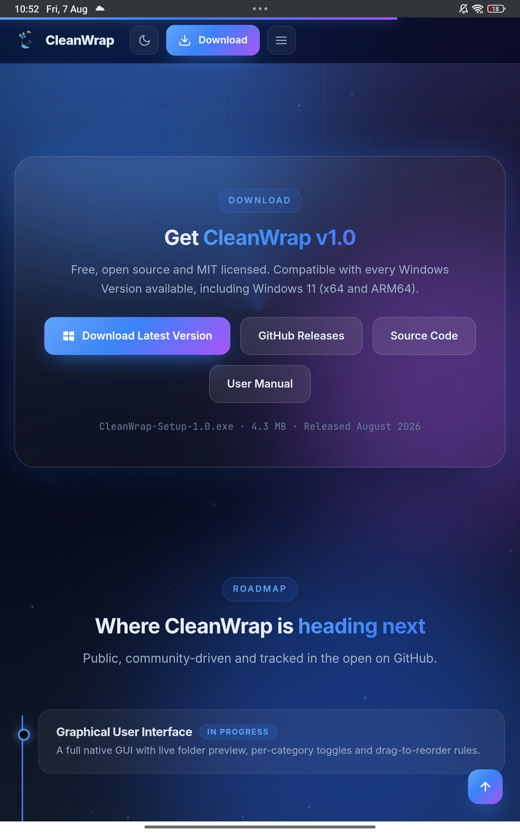

15
DOWNLOAD
TODAY!

